Slide 1

Introduction to Ethical Hacking

Slide 2
Introduction to Ethical Hacking
Ethical hackers
Employed by companies to perform penetration tests
Penetration test
Legal attempt to break into a company’s network to find its weakest link
Tester only reports findings, does not solve problems
Security test
More than an attempt to break in; also includes analyzing company’s security policy and procedures
Tester offers solutions to secure or protect the network

Slide 3
The Role of Security and Penetration Testers
Hackers
Access computer system or network without authorization
Breaks the law; can go to prison
Crackers
Break into systems to steal or destroy data
U.S. Department of Justice calls both hackers
Ethical hacker
Performs most of the same activities but with owner’s permission

Slide 4

Anonymous
As for the literal operation of Anonymous, becoming part of it is as simple as going onto its Internet Relay Chat forums and typing away.
The real-life people involved in Anonymous could be behind their laptops anywhere, from an Internet café in Malaysia to a Michigan suburb.
Anonymous appears to have no spokesperson or leader.
One could participate for a minute or a day in a chat room, and then never go back again.
Anonymous is the future form of Internet-based social activism. They laud the "hactivists" for their actions.

Slide 5

Why Do People Hack
To make security stronger (Ethical Hacking)
Just for fun
Show off
Hack other systems secretly
Notify many people their thought
Steal important information
Destroy enemy’s computer network during the war

Slide 6

What is Ethical Hacking
Also Called – Attack & Penetration Testing, White-hat hacking,
Red teaming
It is Legal
Permission is obtained from the target
Part of an overall security program
Identify vulnerabilities visible from the Internet
Ethical hackers possesses same skills, mindset and tools of
a hacker but the attacks are done in a non-destructive manner
Hacking
Process of breaking into systems for:
Personal or Commercial Gains
Malicious Intent – Causing sever damage to Information & Assets
Conforming to accepted professional standards of conduct
Notes:
‹#›
Red teaming – used for the first time by US government for testing its systems early 90’s
Black & white hat terminology comes from the Hollywood movies where good guys wear white hats and bad guys wear black hats

Slide 7
Types of Hackers
White Hat Hackers:
A White Hat who specializes in penetration testing and in other testing methodologies to ensure the security of an organization's information systems.
Black Hat Hackers:
A Black Hat is the villain or bad guy, especially in a western movie in which such a character would stereotypically wear a black hat in contrast to the hero's white hat.
Gray Hat Hackers:
A Grey Hat, in the hacking community, refers to a skilled hacker whose activities fall somewhere between white and black hat hackers on a variety of spectra

Slide 8
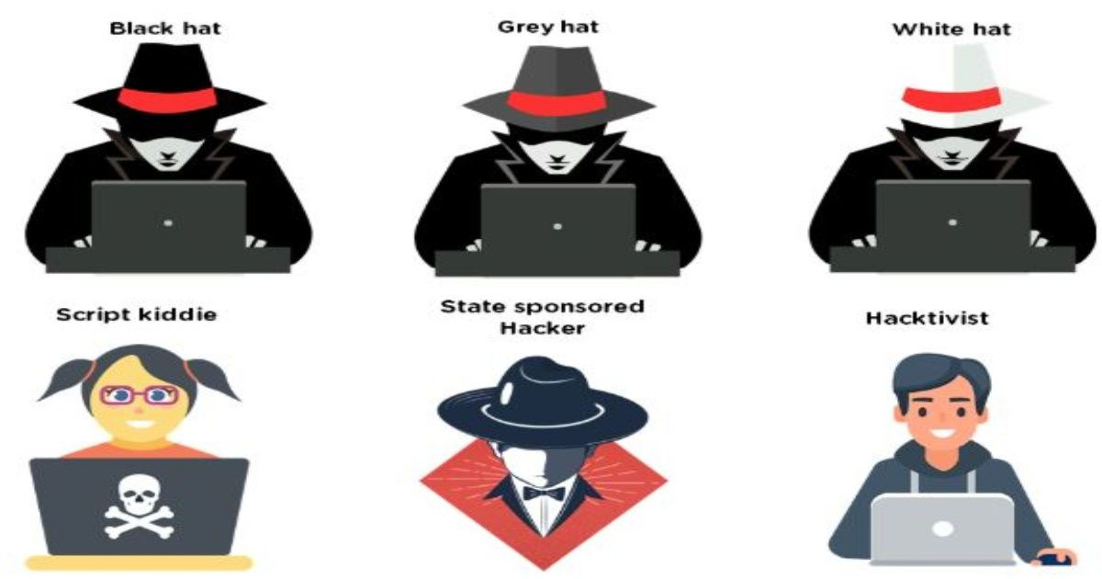
Types of Hackers

Slide 9
Why Can’t We Defend Against Hackers?
There are many unknown security hole
Hackers need to know only one security hole to hack the system
Admin need to know all security holes to defend the system

Slide 10
Why Do We Need Ethical Hacking
Protection from possible External Attacks
Social
Engineering
Organizational
Attacks
Automated
Attacks
Restricted
Data
Accidental Breaches in Security
Denial of
Service (DoS)
Viruses, Trojan Horses,
and Worms

Slide 11
What do hackers do after hacking? (1)
Patch security hole
The other hackers can’t intrude
Clear logs and hide themselves
Install rootkit ( backdoor )
The hacker who hacked the system can use the system later
It contains trojan virus, and so on
Install irc related program
identd, irc, bitchx, eggdrop, bnc

Slide 12
What do hackers do after hacking? (2)
Install scanner program
mscan, sscan, nmap
Install exploit program
Install denial of service program
Use all of installed programs silently

Slide 13
Basic Knowledge Required
The basic knowledge that an Ethical Hacker should have about different fields, is as follows:
Should have basic knowledge of ethical and permissible issues
Should have primary level knowledge of session hijacking
Should know about hacking wireless networks
Should be good in sniffing
Should know how to handle virus and worms
Should have the basic knowledge of cryptography
Should have the basic knowledge of accounts administration
Should know how to perform system hacking

Slide 14
Basic Knowledge Required (con’t)
Should have the knowledge of physical infrastructure hacking
Should have the primary knowledge of social engineering
Should know to how to do sacking of web servers
Should have the basic knowledge of web application weakness
Should have the knowledge of web based password breaking procedure
Should have the basic knowledge of SQL injection
Should know how to hack Linux
Should have the knowledge of IP hacking
Should have the knowledge of application hacking

Slide 15
Denial of Service
If an attacker is unsuccessful in gaining access, they may use readily available exploit code to disable a target as a last resort
Techniques
SYN flood
ICMP techniques
Identical SYN requests
Overlapping fragment/offset bugs
Out of bounds TCP options (OOB)
DDoS

Slide 16
How Can We Protect The System?
Patch security hole often
Encrypt important data
Ex) pgp, ssh
Do not run unused daemon
Remove unused setuid/setgid program
Setup loghost
Backup the system often
Setup firewall
Setup IDS
Ex) snort

Slide 17
What should do after hacked?
Shutdown the system
Or turn off the system
Separate the system from network
Restore the system with the backup
Or reinstall all programs
Connect the system to the network

Slide 18
Ethical Hacking - Process
Preparation
Foot Printing
Enumeration & Fingerprinting
Identification of Vulnerabilities
Attack – Exploit the Vulnerabilities
Gaining Access
Escalating Privilege
Covering Tracks
Creating Back Doors

Slide 19
1.Preparation
Identification of Targets – company websites, mail servers, extranets, etc.
Signing of Contract
Agreement on protection against any legal issues
Contracts to clearly specifies the limits and dangers of the test
Specifics on Denial of Service Tests, Social Engineering, etc.
Time window for Attacks
Total time for the testing
Prior Knowledge of the systems
Key people who are made aware of the testing

Slide 20
2.Footprinting
Collecting as much information about the target
DNS Servers
IP Ranges
Administrative Contacts
Problems revealed by administrators
Information Sources
Search engines
Forums
Databases – whois, ripe, arin, apnic
Tools – PING, whois, Traceroute, DIG, nslookup, sam spade

Slide 21
3.Enumeration & Fingerprinting
Specific targets determined
Identification of Services / open ports
Operating System Enumeration
Methods
Banner grabbing
Responses to various protocol (ICMP &TCP) commands
Port / Service Scans – TCP Connect, TCP SYN, TCP FIN, etc.
Tools
Nmap, FScan, Hping, Firewalk, netcat, tcpdump, ssh, telnet, SNMP Scanner

Slide 22
4.Identification of Vulnerabilities (1)
Vulnerabilities
Insecure Configuration
Weak passwords
Unpatched vulnerabilities in services, Operating systems, applications
Possible Vulnerabilities in Services, Operating Systems
Insecure programming
Weak Access Control

Slide 23
4.Identification of Vulnerabilities (2)
Methods
Unpatched / Possible Vulnerabilities – Tools, Vulnerability information Websites
Weak Passwords – Default Passwords, Brute force, Social Engineering, Listening to Traffic
Insecure Programming – SQL Injection, Listening to Traffic
Weak Access Control – Using the Application Logic, SQL Injection

Slide 24
4.Identification of Vulnerabilities (3)
Tools
Vulnerability Scanners - Nessus, ISS, SARA, SAINT
Listening to Traffic – Ethercap, tcpdump
Password Crackers – John the ripper, LC4, Pwdump
Intercepting Web Traffic – Achilles, Whisker, Legion
Websites
Common Vulnerabilities & Exposures – http://cve.mitre.org
Bugtraq – www.securityfocus.com
Other Vendor Websites

Slide 25
5.Attack – Exploit the Vulnerabilities (1)
Obtain as much information (trophies) from the Target Asset
Gaining Normal Access
Escalation of privileges
Obtaining access to other connected systems
Last Ditch Effort – Denial of Service

Slide 26
5.Attack – Exploit the Vulnerabilities (2)
Network Infrastructure Attacks
Connecting to the network through modem
Weaknesses in TCP / IP, NetBIOS
Flooding the network to cause DOS
Operating System Attacks
Attacking Authentication Systems
Exploiting Protocol Implementations
Exploiting Insecure configuration
Breaking File-System Security

Slide 27
5.Attack – Exploit the Vulnerabilities (3)
Application Specific Attacks
Exploiting implementations of HTTP, SMTP protocols
Gaining access to application Databases
SQL Injection
Spamming

Slide 28
5.Attack – Exploit the Vulnerabilities (4)
Exploits
Free exploits from Hacker Websites
Customised free exploits
Internally Developed
Tools – Nessus, Metasploit Framework,

Slide 29
6. Gaining access:
Enough data has been gathered at this point to make an informed attempt to access the target
Techniques
Password eavesdropping
File share brute forcing
Password file grab
Buffer overflows

Slide 30
7. Escalating Privileges
If only user-level access was obtained in the last step, the attacker will now seek to gain complete control of the system
Techniques
Password cracking
Known exploits

Slide 31
8. Covering Tracks
Once total ownership of the target is secured, hiding this fact from system administrators becomes paramount, lest they quickly end the romp.
Techniques
Clear logs
Hide tools

Slide 32
9. Creating Back Doors
Trap doors will be laid in various parts of the system to ensure that privileged access is easily regained at the whim of the intruder
Techniques
Create rogue user accounts
Schedule batch jobs
Infect startup files
Plant remote control services
Install monitoring mechanisms
Replace apps with trojans

Slide 33
Thank You

